Slide 2
Find Existing EFIT
ssh -Y username@irisb
module load idl
efitviewer

Slide 3
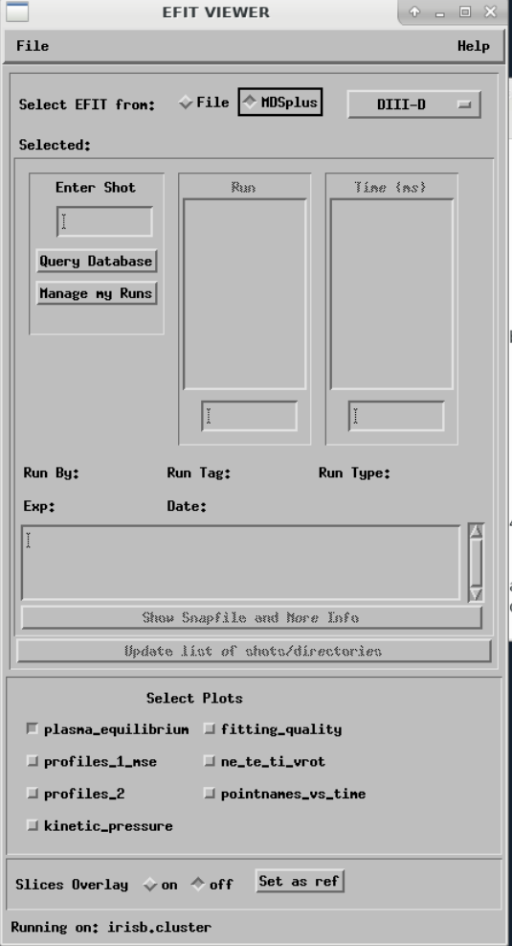
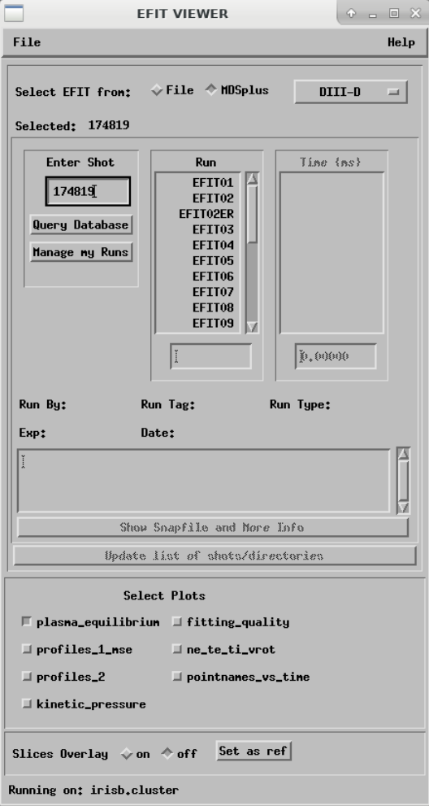
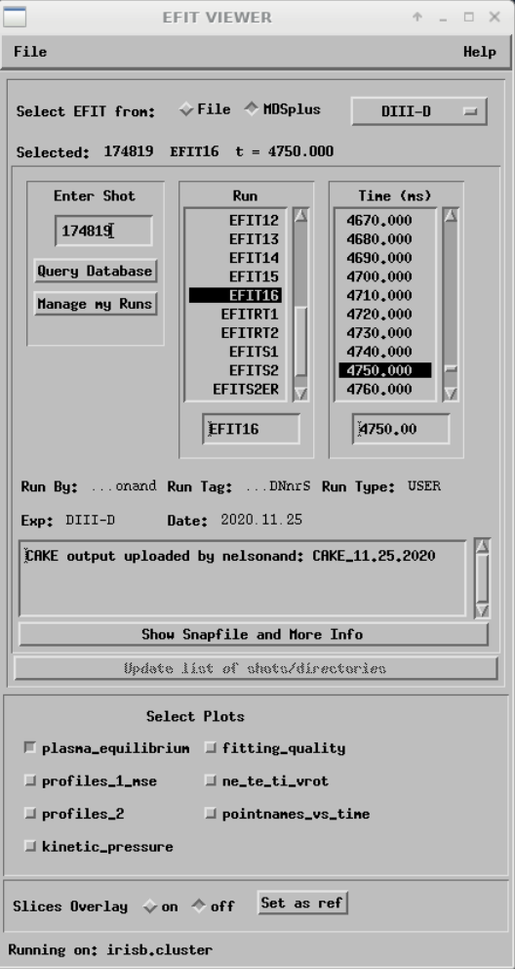

Slide 4
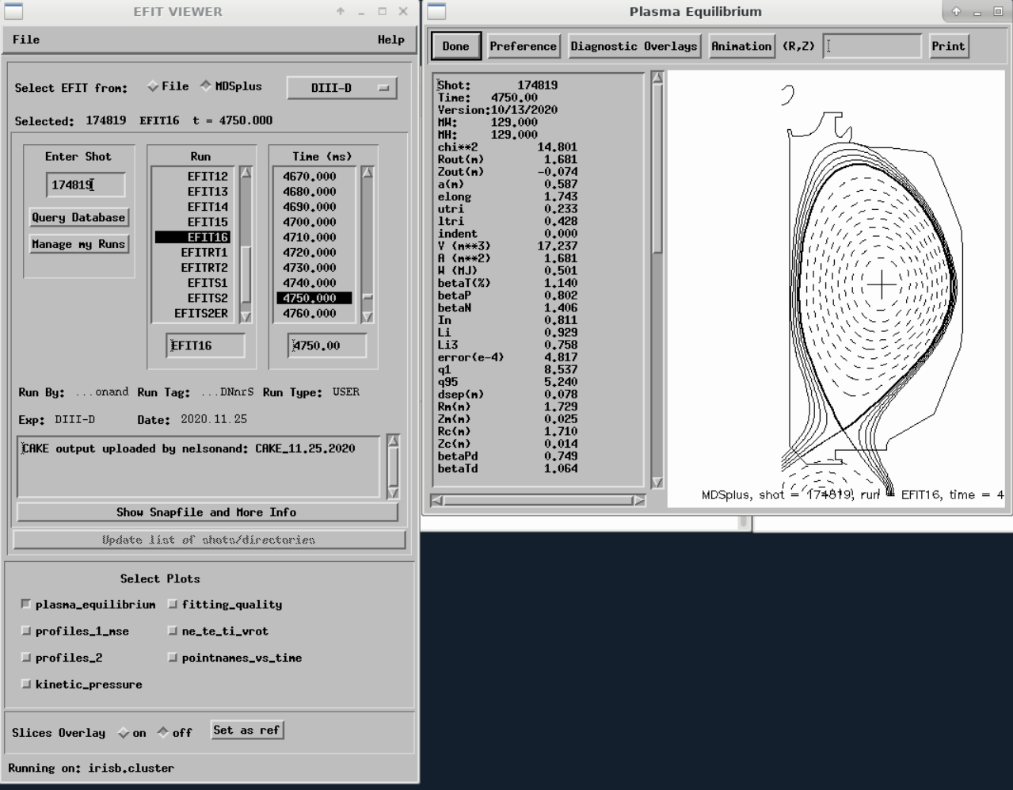

Slide 5
Save the EFIT
ssh -Y username@irisb
module load omfit/unstable
omfit

Slide 6
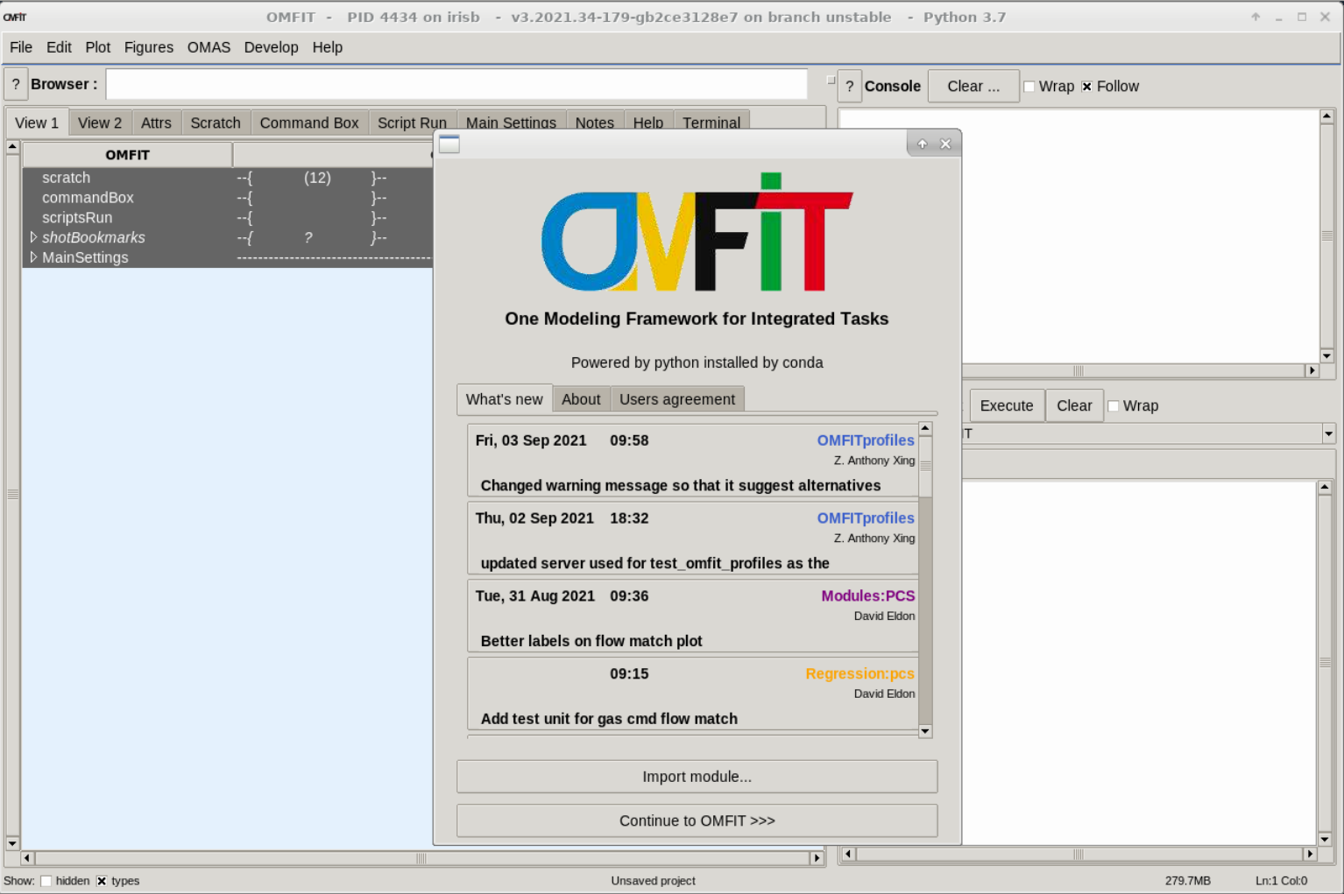

Slide 7
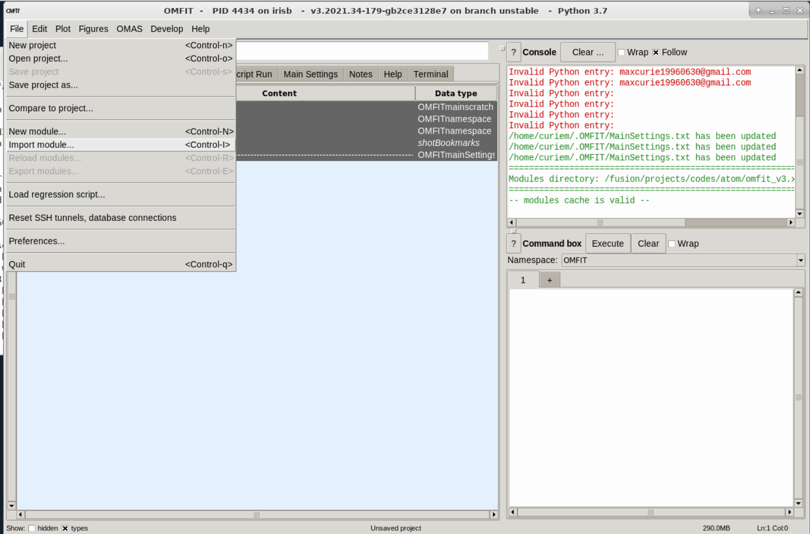

Slide 8
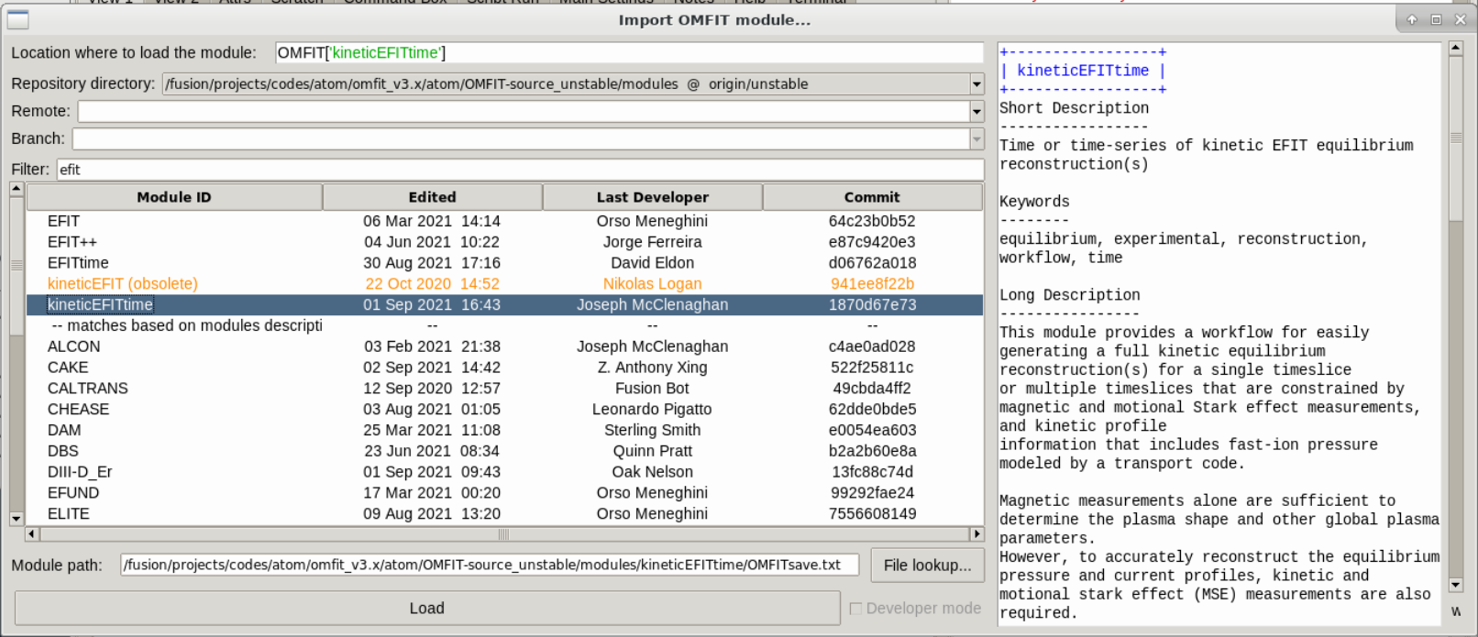

Slide 9
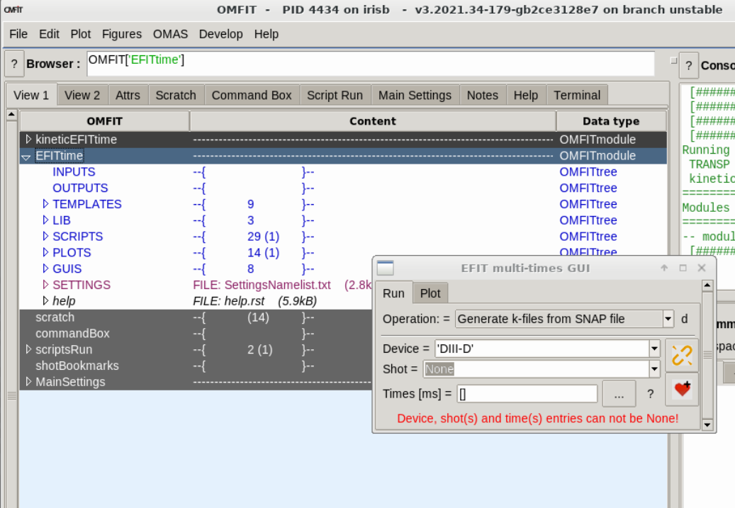
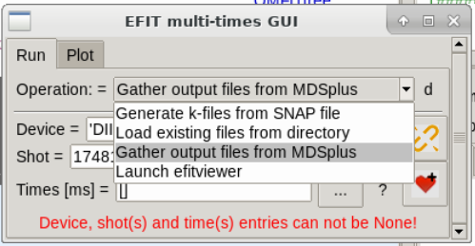

Slide 10
https://omfit.io/modules/mod_kineticEFITtime.html#mod-kineticefittime

